Slide 1
Lec - 10

Slide 2

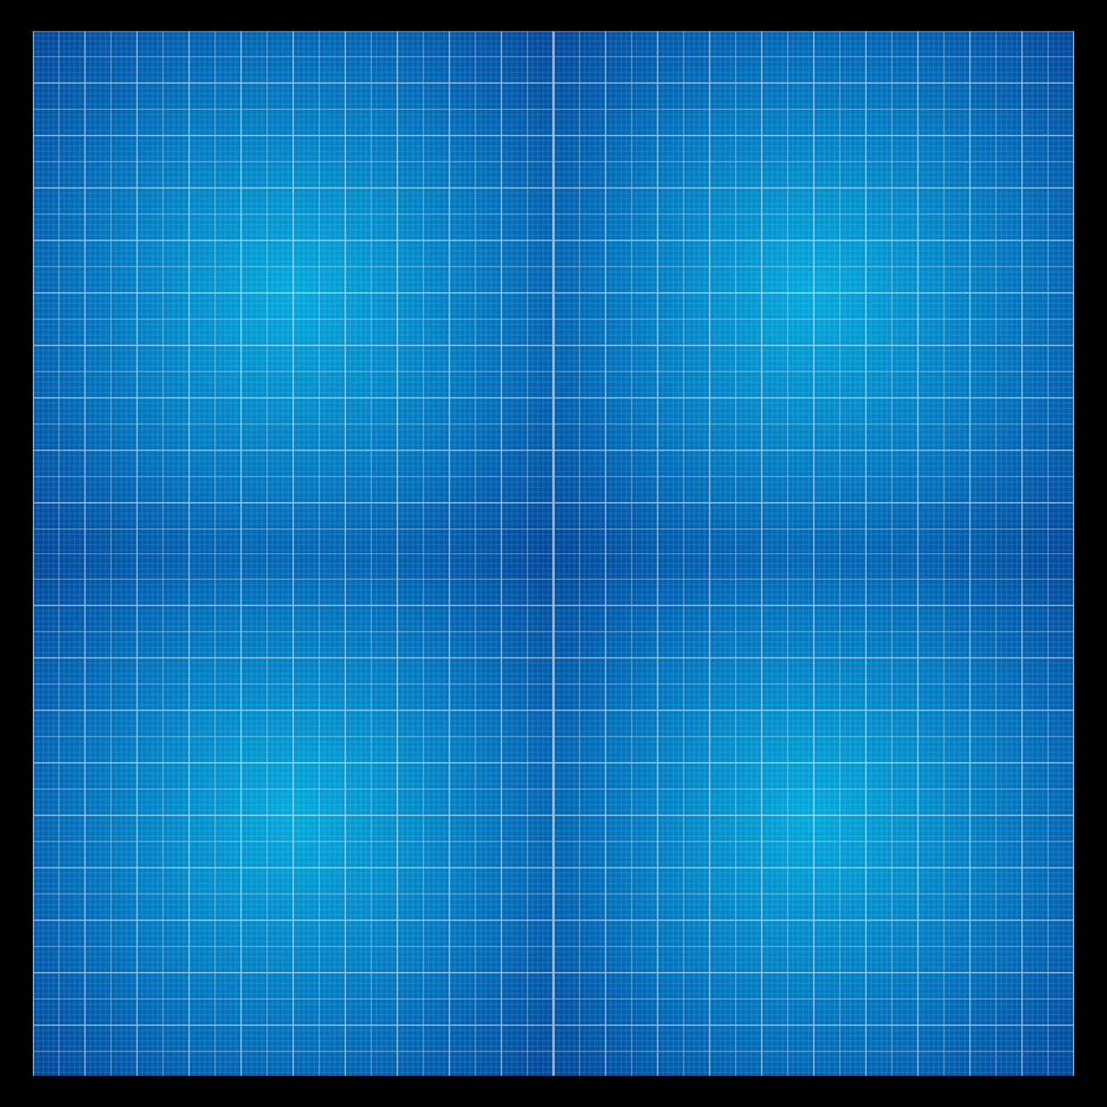
Cartesian sign convention
Y
5
4
3
2
1
X
2F₁
F₁
1
2
3
4
5
2F₂
-5
-4
-3
-2
-1
O
F₂
In front of lens
-1
Behind the lens
-2
-3
-4
-5

Slide 3
Cartesian sign convention
1. Object should be always to the left of the lens.
(+)
Y
Distance
2. All distances parallel to principal axis are measured from the optical centre of the lens.
Object
A
(–)
Distance
Distance
(+)
B'
3. The distances to the right of origin are +ve
The distances to the left of origin are –ve
2F₁
B
F₁
O
2F₁
F₁
X
Optical centre
A'
4. The distances measured perpendicular to and above the principal axis are +ve
Distance
Image
(–)
5. The distances measured perpendicular to and below the principal axis are –ve

Slide 4
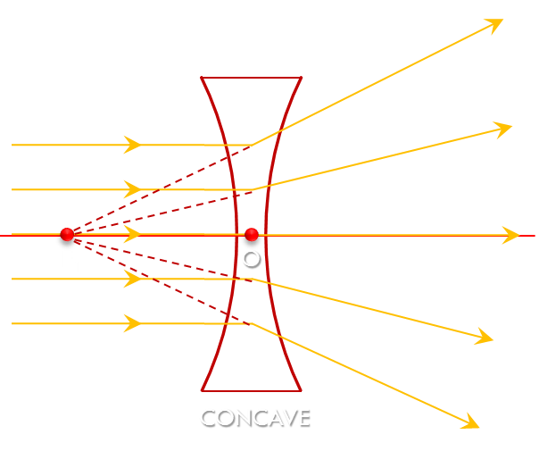
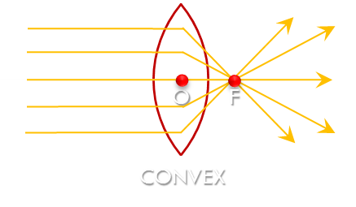
Cartesian sign convention
1. Object should be always to the left of the lens.
2. All distances parallel to principal axis are measured from the optical centre of the lens.
3. The distances to the right of origin are +ve
The distances to the left of origin are –ve
4. The distances measured perpendicular to and above the principal axis are +ve
5. The distances measured perpendicular to and below the principal axis are –ve
6. Focal length of convex lens is +ve
Focal length of concave lens is –ve

Slide 5

Lens Formula
1
1
1
Magnification (M)
–
=
v
u
f
size of the image
(h₂)
v
Image distance
Magnification
=
size of the object
(h₁)
u
Object distance
M = 1/2 i.e. less
than 1
M = 2 i.e. greater
than 1
If size of Image is 4
If size of Image is 2
If size of Image is 4
f
Focal length
4
h₂
v
2
M = 1
4
If M > 1, image is magnified
M =
=
4
h₁
u
4
If M < 1, image is diminished
2
size of object is 4
size of object is 4
size of object is 2
If M = 1, image is of the same size

Slide 6
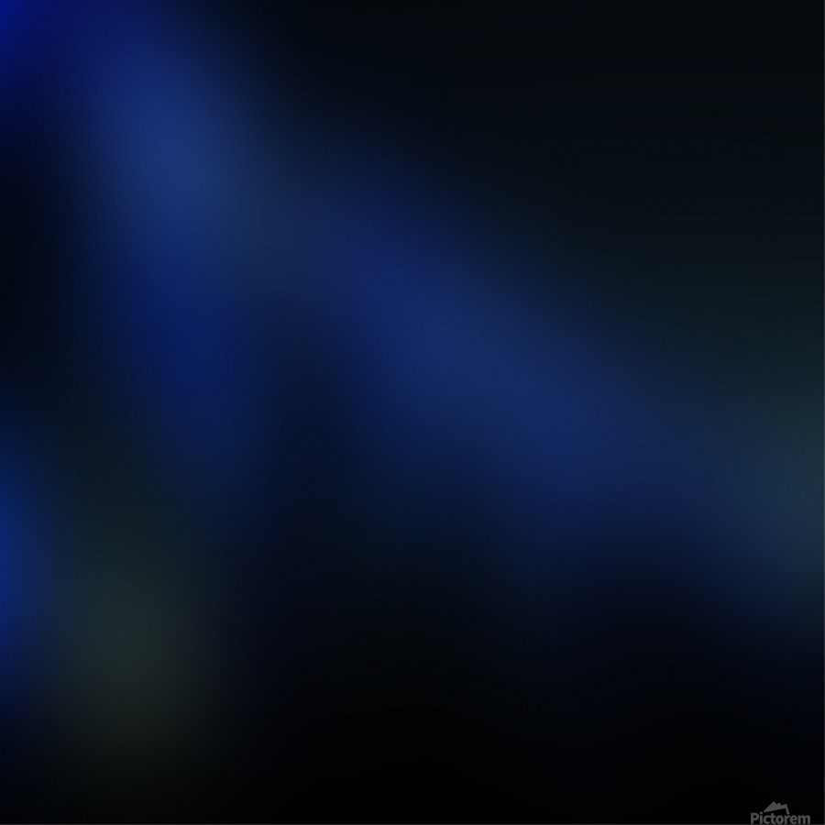
TYPE - A
PROBLEMS BASED ON THE
FORMULA
1
1
1
-
=
v
u
f

Slide 7
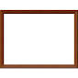


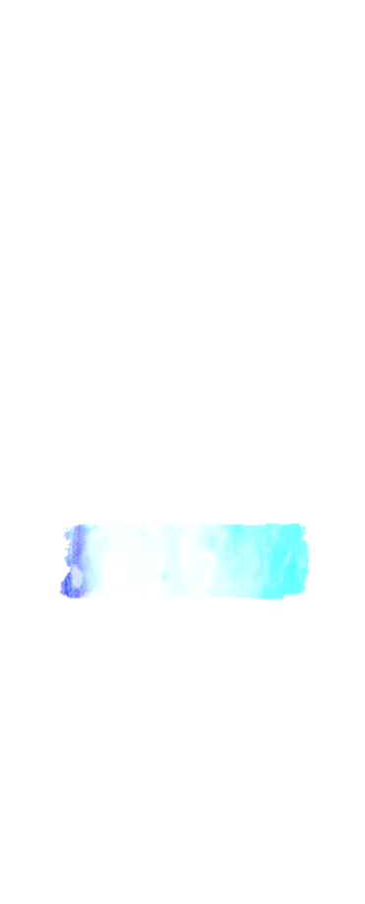


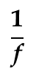



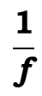

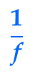
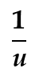

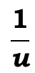




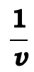








1
If an object of 7 cm height is placed at a distance of 12 cm from a convex lens of focal length 8 cm, find the position of the image.
$$\frac{\text{1}}{\text{v}}$$
$$\frac{\text{1}}{\text{u}}$$
$$\frac{\text{1}}{\text{f}}$$
–
=
Object distance (u)
= 12 cm
Given :
-
Focal length (f)
= 8 cm
A
To find :
Image distance (v)
= ?
12 cm
8 cm
7 cm
O
B'
$$\frac{\text{1}}{\text{v}}$$
$$\frac{\text{1}}{\text{u}}$$
$$\frac{\text{1}}{\text{f}}$$
$$\frac{\text{1}}{\text{v}}$$
$$\frac{\text{3 − 2}}{\text{24}}$$
B
F₁
F₂
2F₂
Formula :
–
=
∴
=
2F₁
?
$$\frac{\text{1}}{\text{v}}$$
$$\frac{\text{1}}{\text{u}}$$
$$\frac{\text{1}}{\text{f}}$$
$$\frac{\text{1}}{\text{v}}$$
$$\frac{\text{1}}{\text{24}}$$
Solution :
–
=
∴
=
A'
$$\frac{\text{1}}{\text{v}}$$
$$\frac{\text{1}}{\text{f}}$$
$$\frac{\text{1}}{\text{u}}$$
$$\frac{\text{24}}{\text{1}}$$
∴
=
+
$$\text{v}$$
=
∴
$$\frac{\text{1}}{\text{v}}$$
$$\frac{\text{1}}{\text{8}}$$
$$\frac{\text{1}}{\text{(– 12)}}$$
The image is formed at a distance of 24 cm on the other side of the convex lens.
∴
=
+
∴ v = 24 cm
$$\frac{\text{1}}{\text{v}}$$
$$\frac{\text{1}}{\text{8}}$$
$$\frac{\text{1}}{\text{12}}$$
∴
=
–

Slide 8















A convex lens of focal length 10 cm is placed at a distance of 12 cm from a wall. How far from the lens should an object be placed so as to form its real image on the wall ?
2
$$\frac{\text{1}}{\text{v}}$$
$$\frac{\text{1}}{\text{u}}$$
$$\frac{\text{1}}{\text{f}}$$
Image distance (v)
= + 12 cm
–
=
Given :
Focal length (f)
= 10 cm
A
?
To find :
Object distance (u)
= ?
O
B΄
$$\frac{\text{1}}{\text{v}}$$
$$\frac{\text{1}}{\text{u}}$$
$$\frac{\text{1}}{\text{f}}$$
B
F₂
Formula :
–
=
$$\frac{\text{1}}{\text{u}}$$
$$\frac{\text{– 1}}{\text{60}}$$
2F₁
F₁
2F₂
∴
=
10cm
$$\frac{\text{1}}{\text{f}}$$
A΄
Solution :
$$\frac{\text{1}}{\text{v}}$$
$$\frac{\text{1}}{\text{u}}$$
12cm
–
=
$$\frac{\text{– 60}}{\text{1}}$$
∴
$$\text{u}$$
=
$$\frac{\text{1}}{\text{v}}$$
$$\frac{\text{1}}{\text{f}}$$
$$\frac{\text{1}}{\text{u}}$$
The object should be placed at a distance of 60 cm from the lens to form a real image on the wall.
∴
–
=
∴ u = -60 cm
$$\frac{\text{1}}{\text{12}}$$
$$\frac{\text{1}}{\text{10}}$$
$$\frac{\text{1}}{\text{u}}$$
∴
–
=
$$\frac{\text{1}}{\text{u}}$$
$$\frac{\text{5}\text{ –} 6}{\text{60}}$$
∴
=

Slide 9
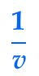
















3
A boy was standing at a distance of 20 cm from a convex lens. If the focal length of the lens is 80 cm, find at what distance will the image of the boy be formed ?
$$\frac{\text{1}}{\text{v}}$$
$$\frac{\text{1}}{\text{u}}$$
$$\frac{\text{1}}{\text{f}}$$
Object distance (u)
= 20 cm
A'
?
–
=
Given :
-
Focal length (f)
= 80 cm
A
20 cm
To find :
Image distance (v)
= ?
O
B'
B
F₂
$$\frac{\text{1}}{\text{v}}$$
$$\frac{\text{1}}{\text{u}}$$
$$\frac{\text{1}}{\text{f}}$$
2F₁
F₁
2F₂
Formula :
–
=
$$\frac{\text{1}}{\text{v}}$$
$$\frac{\text{1 − 4}}{\text{80 }}$$
80 cm
∴
=
$$\frac{\text{1}}{\text{v}}$$
$$\frac{\text{1}}{\text{u}}$$
$$\frac{\text{1}}{\text{f}}$$
Solution :
–
=
$$\frac{\text{1}}{\text{v}}$$
$$\frac{\text{– 3}}{\text{80 }}$$
∴
=
$$\frac{\text{1}}{\text{v}}$$
$$\frac{\text{1}}{\text{f}}$$
$$\frac{\text{1}}{\text{u}}$$
∴
=
+
$$\frac{\text{– 80}}{\text{3}}$$
∴
$$\text{v}$$
=
$$\frac{\text{1}}{\text{v}}$$
$$\frac{\text{1}}{\text{80}}$$
$$\frac{\text{1}}{\text{– 20}}$$
The image of the boy is formed at a distance of 26.67 cm on the same side of the lens.
∴
=
+
∴ v = -26.67 cm
$$\frac{\text{1}}{\text{v}}$$
$$\frac{\text{1}}{\text{80}}$$
$$\frac{\text{1}}{\text{ 20}}$$
∴
=
-

Slide 10




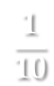
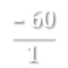
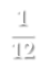

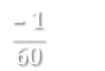





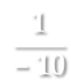
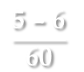
4
An object is placed at a distance of 10 cm from a convex lens of focal length 12 cm. Find the position and nature of the image.
Given :
Object distance (u)
= 10 cm
$$\frac{\text{1}}{\text{v}}$$
$$\frac{\text{1}}{\text{u}}$$
$$\frac{\text{1}}{\text{f}}$$
-
–
=
A΄
?
Focal length (f)
= 12 cm
A
To find :
Image Position (v)
= ?
10 cm
Nature of Image
= ?
O
B΄
F₁
B
F₂
2F₂
$$\frac{\text{1}}{\text{v}}$$
$$\frac{\text{1}}{\text{u}}$$
$$\frac{\text{1}}{\text{f}}$$
2F₁
Formula :
–
=
$$\frac{\text{1}}{\text{v}}$$
$$\frac{\text{5}\text{ – }\text{6}}{\text{60}}$$
∴
=
12 cm
$$\frac{\text{1}}{\text{v}}$$
$$\frac{\text{1}}{\text{u}}$$
$$\frac{\text{1}}{\text{f}}$$
$$\frac{\text{1}}{\text{v}}$$
$$\frac{\text{– }\text{1}}{\text{60}}$$
Solution :
–
=
=
∴
$$\frac{\text{1}}{\text{v}}$$
$$\frac{\text{1}}{\text{f}}$$
$$\frac{\text{1}}{\text{u}}$$
∴
=
+
$$\frac{\text{– }\text{60}}{\text{1}}$$
∴
v
=
$$\frac{\text{1}}{\text{v}}$$
$$\frac{\text{1}}{\text{12}}$$
$$\frac{\text{1}}{\text{– }\text{10}}$$
∴
=
+
The image is formed at a distance of 60 cm on the same side of the lens, it is a virtual and erect image.
∴ v = -60 cm
$$\frac{\text{1}}{\text{v}}$$
$$\frac{\text{1}}{\text{12}}$$
$$\frac{\text{1}}{\text{10}}$$
∴
=
–

Slide 11
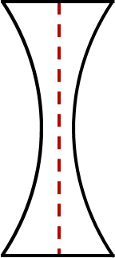


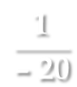


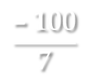
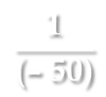
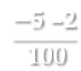


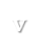
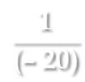
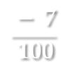


5
An object is placed at a distance of 50 cm from a concave lens of focal length 20 cm. Find the nature and position of the image.
$$\frac{\text{1}}{\text{v}}$$
$$\frac{\text{1}}{\text{u}}$$
$$\frac{\text{1}}{\text{f}}$$
–
=
Object distance (u)
= 50 cm
Given :
-
?
A'
Focal length (f)
-
= 20 cm
A
To find :
Image distance (v)
= ?
50 cm
$$\frac{\text{1}}{\text{v}}$$
$$\frac{\text{−}\text{5 –2}}{\text{ 100}}$$
O
$$\frac{\text{1}}{\text{v}}$$
$$\frac{\text{1}}{\text{u}}$$
$$\frac{\text{1}}{\text{f}}$$
∴
=
B
B'
F₂
Formula :
–
=
2F₁
F₁
2F₂
20 cm
$$\frac{\text{1}}{\text{v}}$$
$$\frac{\text{1}}{\text{u}}$$
$$\frac{\text{1}}{\text{f}}$$
$$\frac{\text{1}}{\text{v}}$$
$$\frac{\text{ − }\text{7}}{\text{ 100}}$$
Solution :
–
=
∴
=
$$\frac{\text{1}}{\text{v}}$$
$$\frac{\text{1}}{\text{f}}$$
$$\frac{\text{1}}{\text{u}}$$
$$\frac{\text{– 100}}{\text{7}}$$
∴
=
+
∴
$$\text{v}$$
=
$$\frac{\text{1}}{\text{v}}$$
$$\frac{\text{1}}{\text{(–} \text{20)}}$$
$$\frac{\text{1}}{\text{(– 50)}}$$
∴ v = -14.28 cm
The image is formed at a distance of 14.28 cm on the same side of the concave lens.
∴
=
+
$$\frac{\text{1}}{\text{v}}$$
$$\frac{\text{1}}{\text{– 20}}$$
$$\frac{\text{1}}{\text{50}}$$
∴
=
–

Slide 12
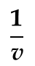



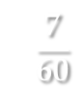




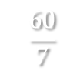



An image was formed at a distance of 60 cm on the other side of the lens. If the object distance is 10 cm, find the focal length of the lens.
6
A
Given :
Image distance (v)
= 60 cm
10 cm
Object distance (u)
-
O
A΄
= 10 cm
2F₁
F₁
B
F₂
2F₂
To find :
Focal length (f)
= ?
$$\frac{\text{1}}{\text{v}}$$
$$\frac{\text{1}}{\text{u}}$$
$$\frac{\text{1}}{\text{f}}$$
?
60 cm
B΄
Formula :
–
=
$$\frac{\text{7}}{\text{60}}$$
$$\frac{\text{1}}{\text{f}}$$
∴
=
$$\frac{\text{1}}{\text{v}}$$
$$\frac{\text{1}}{\text{u}}$$
$$\frac{\text{1}}{\text{f}}$$
Solution :
–
=
$$\frac{\text{60}}{\text{7}}$$
∴
=
$$\text{f}$$
$$\frac{\text{1}}{\text{60}}$$
$$\frac{\text{1}}{\text{– 10}}$$
$$\frac{\text{1}}{\text{f}}$$
∴
–
=
∴ f = 8.57 cm
The focal length of the lens is 8.57 cm.
$$\frac{\text{1}}{\text{60}}$$
$$\frac{\text{1}}{\text{10}}$$
$$\frac{\text{1}}{\text{f}}$$
∴
+
=
$$\frac{\text{1 + 6}}{\text{60}}$$
$$\frac{\text{1}}{\text{f}}$$
∴
=

Slide 13
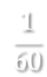
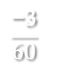




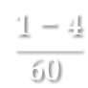


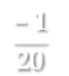


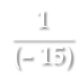
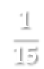

7
An object is placed at a distance of 15 cm from a convex lens. If the focal length of the lens is 60 cm. Find the image distance.
?
$$\frac{\text{1}}{\text{v}}$$
$$\frac{\text{1}}{\text{u}}$$
$$\frac{\text{1}}{\text{f}}$$
Object distance (u)
= 15 cm
A'
–
=
Given :
-
Focal length (f)
= 60 cm
A
15 cm
To find :
Image distance (v)
= ?
O
B'
B
F₂
$$\frac{\text{1}}{\text{f}}$$
$$\frac{\text{1}}{\text{v}}$$
$$\frac{\text{1 − 4}}{\text{60 }}$$
2F₁
F₁
2F₂
$$\frac{\text{1}}{\text{v}}$$
$$\frac{\text{1}}{\text{u}}$$
∴
=
Formula :
–
=
60 cm
$$\frac{\text{1}}{\text{v}}$$
$$\frac{\text{1}}{\text{u}}$$
$$\frac{\text{1}}{\text{f}}$$
$$\frac{\text{1}}{\text{v}}$$
$$\frac{\text{−3}}{\text{60}}$$
Solution :
–
=
∴
=
$$\frac{\text{1}}{\text{v}}$$
$$\frac{\text{1}}{\text{f}}$$
$$\frac{\text{1}}{\text{u}}$$
$$\frac{\text{1}}{\text{v}}$$
$$\frac{\text{– }\text{1}}{\text{20}}$$
∴
=
+
=
∴
$$\frac{\text{1}}{\text{v}}$$
$$\frac{\text{1}}{\text{60}}$$
$$\frac{\text{1}}{\text{(– 15)}}$$
∴
=
+
∴ v = -20 cm
The image of the boy is formed at a distance of 20 cm on the same side of the lens.
$$\frac{\text{1}}{\text{v}}$$
$$\frac{\text{1}}{\text{60}}$$
$$\frac{\text{1}}{\text{15}}$$
∴
=
–

Slide 14
Thank You

